Slide 1
Topic 3
Algorithms and Flow Diagrams

Slide 2
What is an algorithm?

Slide 3







Slide 4



Algorithm
An algorithm is a set of steps that define instructions to complete a task.
They must be:
Precise: Executed in order is important.
Defined: Repeateable, consistent results
Finite: With a clear begin and end

Slide 5


Slide 6

Robot prepares the perfect burger?

Slide 7
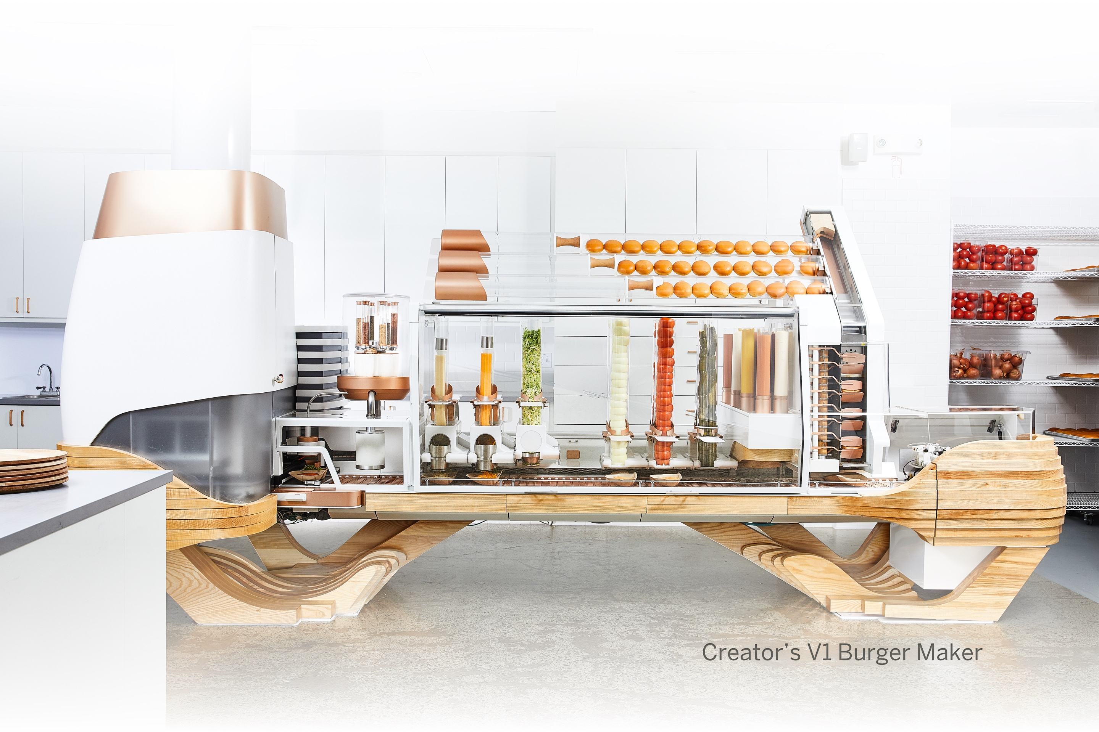
Does the Creator V1 Burger Maker know how to cook?

Slide 8
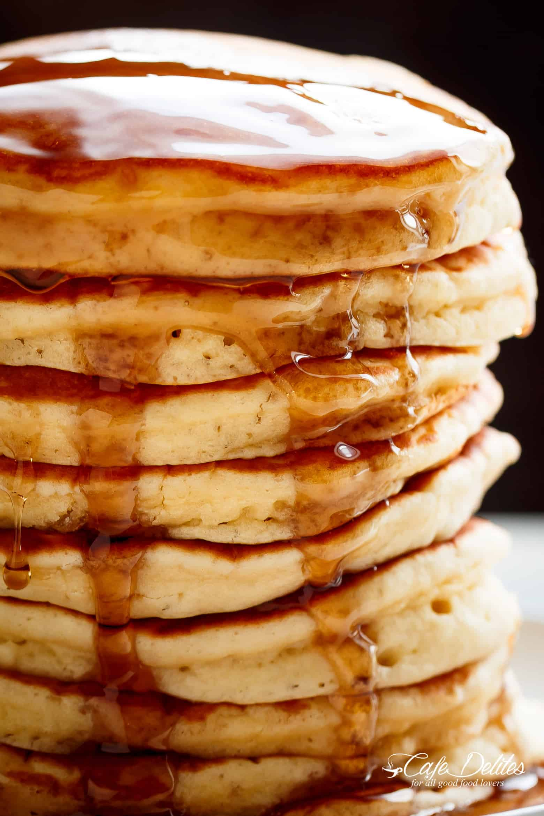
Algorithm for Hot Cakes
Mix flour, eggs and milk in a container
Mix
Pre-heat pan
Pour the mix into the pan
Flip the hot cake
Enjoy!

Slide 9
How much flour?
How many eggs?
How much milk?
How long do you have to mix the ingredients? How? In what direction?
How do you turn on the stove?
What temperature do you need to pre-heat the pan?
How do you pour the batter into the pan? For how long?
What size of hot cake do you want to make?

Slide 10


By following an algorithm step-by-step, the computer does not have to understand what is going on

Slide 11
Algorithm Design
The computer does not need to understand an algorithm, as long as it can execute it.
A good programmer has to understand all aspects and details of the algorithm.
The job of a programmer is to translate algorithm steps into lines of code.

Slide 12
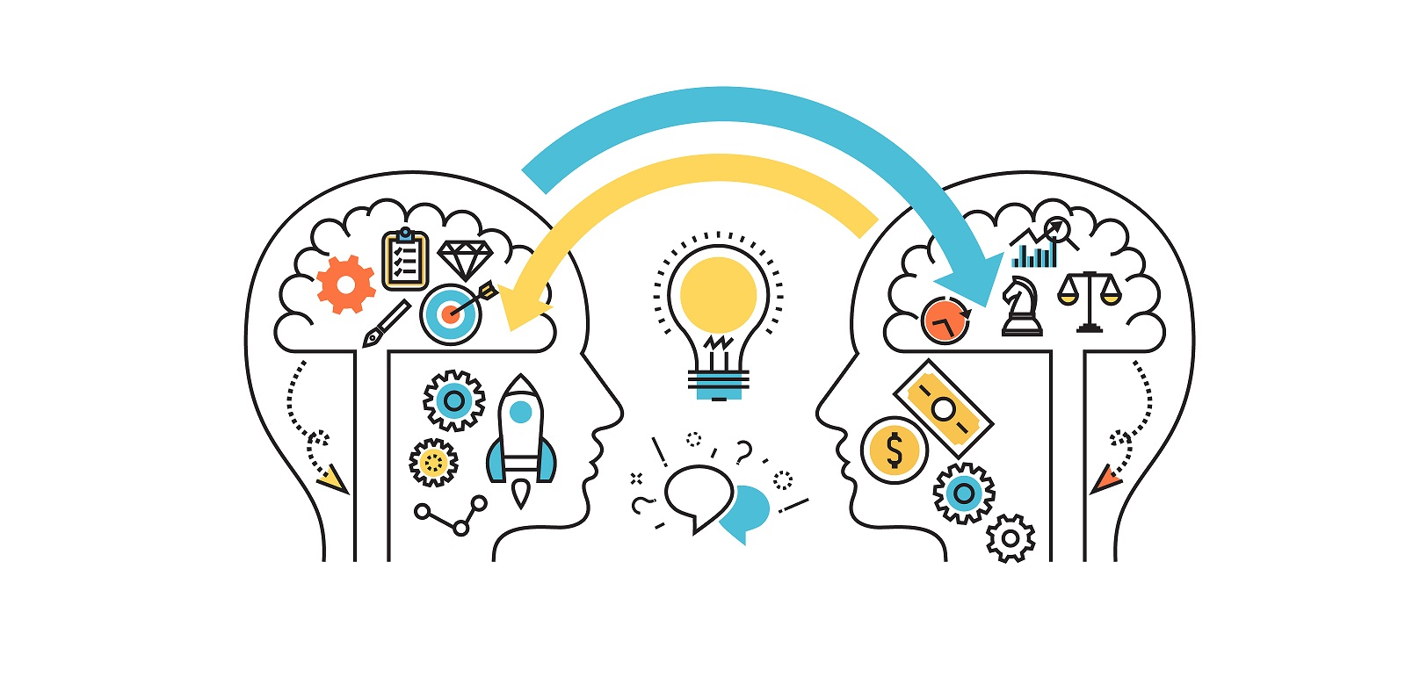
Designing algorithms is highly creative work

Slide 13
How can we represent an algorithm?
Flow chart
Pseudocode

